Slide 1
Probability and Estimation
Donghai Guan
NUAA

Slide 2
Probability Overview
Events
  discrete random variables, continuous random variables, compound events
Axioms of probability
  What defines a reasonable theory of uncertainty
Independent events
Conditional probabilities
Bayes rule and beliefs
Joint probability distribution
Expectations
Independence, Conditional independence

Slide 3
Random Variables
Informally, A is a random variable if
  A denotes something about which we are uncertain
  perhaps the outcome of a randomized experiment
Examples
  A=True if a randomly drawn person from our class is female
  A=The hometown of a randomly drawn person from our class
  A=True if two randomly drawn persons from our class have same birthday
Define P(A) as “the fraction of possible worlds in which A is true” or “the fraction of times A holds, in repeated runs of the random experiment”
  The set of possible worlds is called the sample space, S
  A random variable A is a function defined over S
  A: S → {0,1}
Notes:
Tossing a coin: {Head, Tail}
Rolling a die: {1,2,3,4,5,6}

Slide 4
A little formalism
A sample space S (e.g., set of students in our class)
  aka the set of possible worlds
A random variable is a function defined over the sample space
  Gender: S→{m,f}, Height:S→Reals
An event is a subset of S
  e.g., the subset of S for which Gender=f
  e.g., the subset of S for which (Gender=m) and (eyecolor=blue)
We are often interested in probabilities of specific events
And of specific events conditioned on other specific events

Slide 5
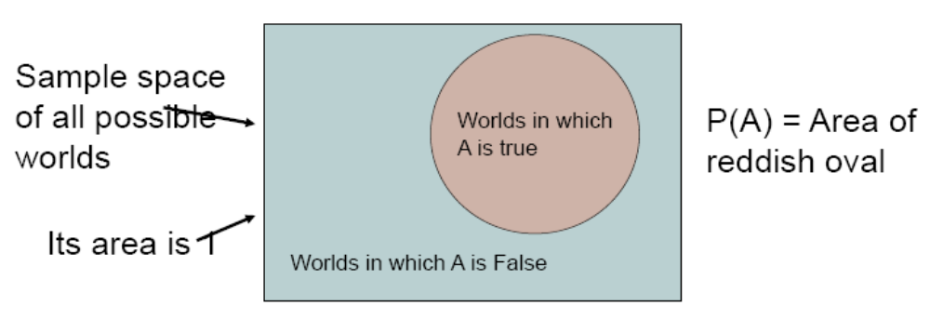
Visualizing A

Slide 6
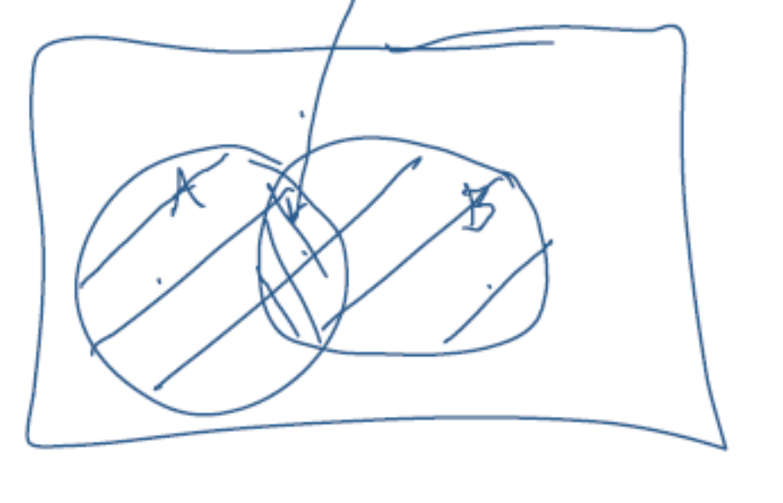
The Axioms of Probability
0 <= P(A) <=1
P(True)=1
P(False)=0
P(A or B)=P(A) + P(B) –P(A and B)

Slide 7
Interpreting the axioms
The area of A can’t get any smaller than 0
And a zero area would mean no world could ever have A true
The area of A can’t get any larger than 1
And an area of 1 would mean all worlds will have A true

Slide 8
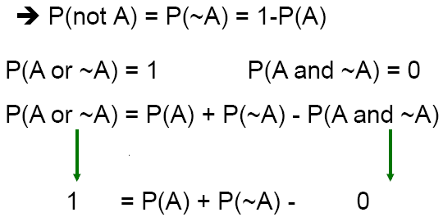
Theorems from the Axioms
0 <= P(A) <=1, P(True)=1, P(False)=0
P(A or B)=P(A) + P(B) –P(A and B)

Slide 9
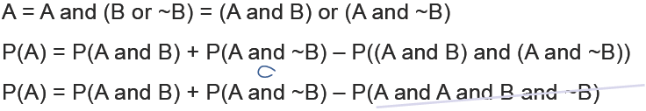
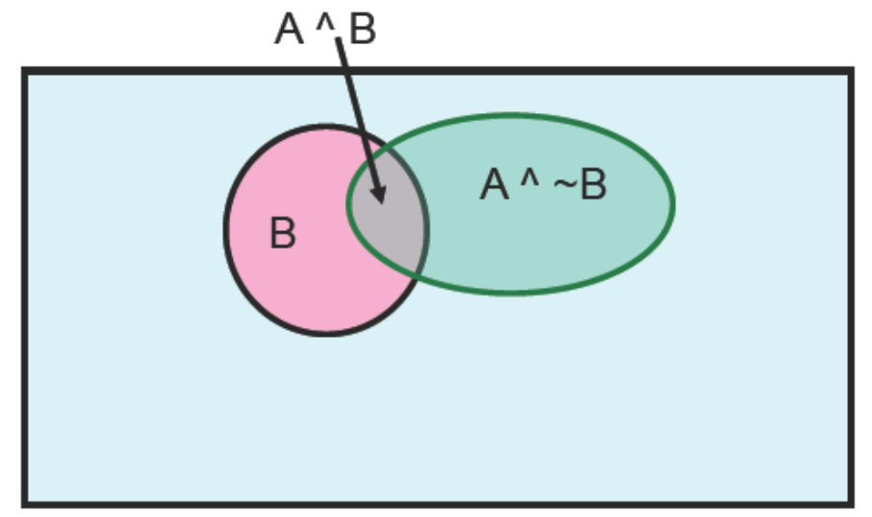
Elementary Probability in Pictures
P(~A) + P(A) =1
P(A)=P(A ^ B) + P(A ^ ~B)

Slide 10
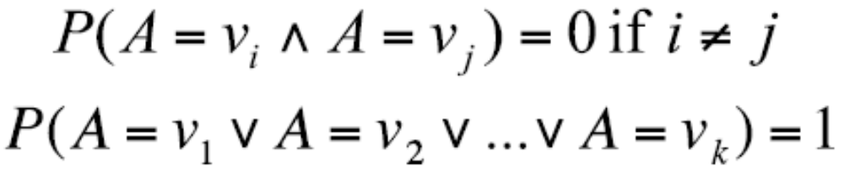
Multivalue Discrete Random Variables
Suppose A can take more than 2 values
A is a random variable with arity k if it can take on exactly one value out of {v₁,v₂,…,v_{k}}
Thus…

Slide 11
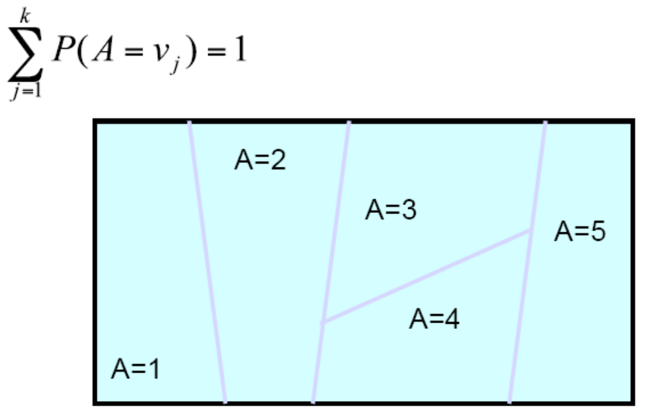
Elementary Probability in Pictures

Slide 12
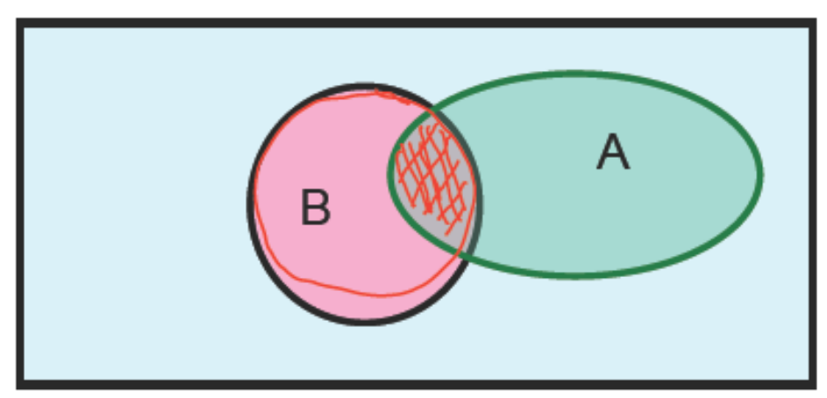
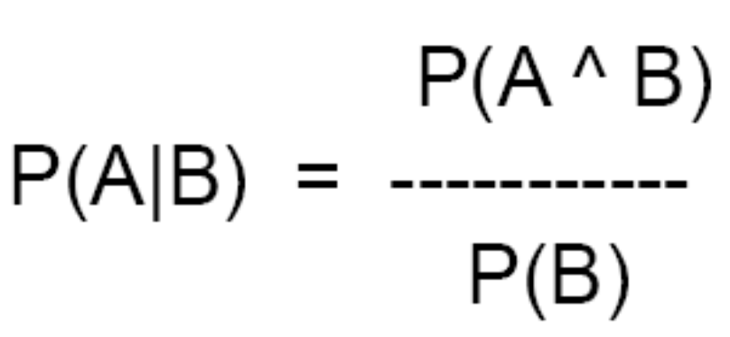
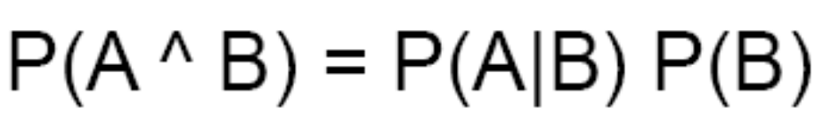
Definition of Conditional Probability
Corollary: The Chain Rule

Slide 13
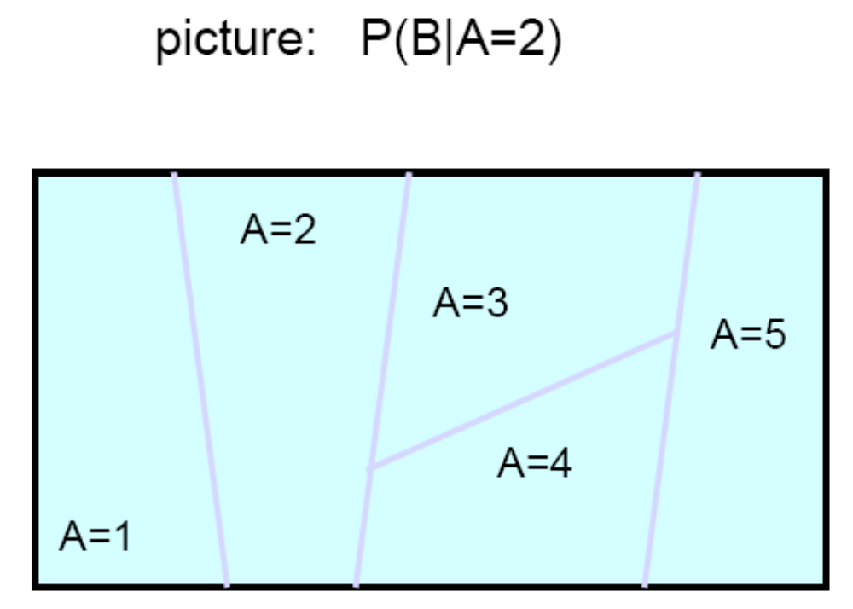
Conditional Probability in Pictures

Slide 14
Independent Events
Definition: two events A and B are independent if Pr(A and B)=Pr(A)*Pr(B)
Intuition: knowing A tells us nothing about the value of B (and vice versa)

Slide 15
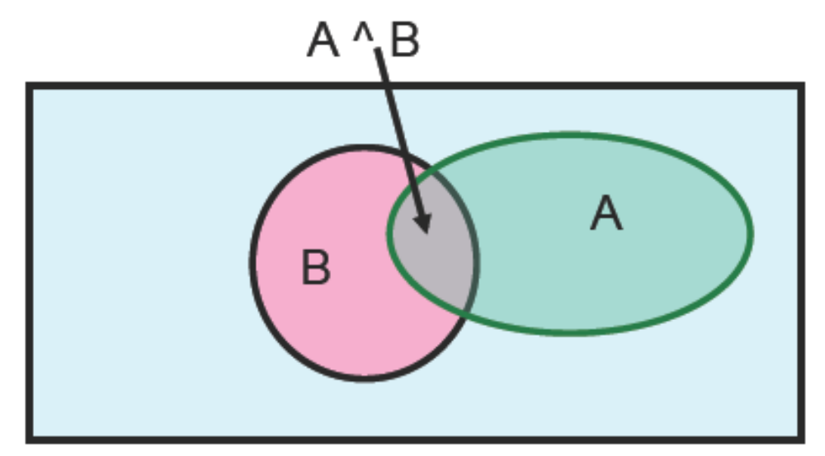
Elementary Probability in Pictures
Let’s write 2 expressions for P(A ^ B)

Slide 16
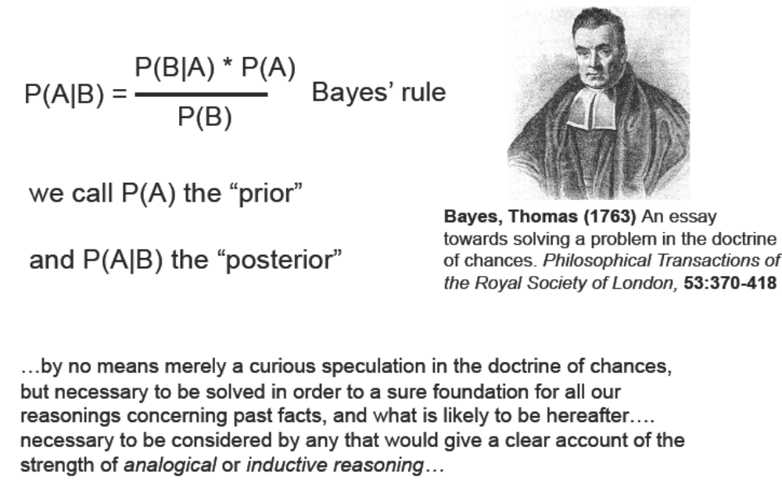
Bayes Rule

Slide 17
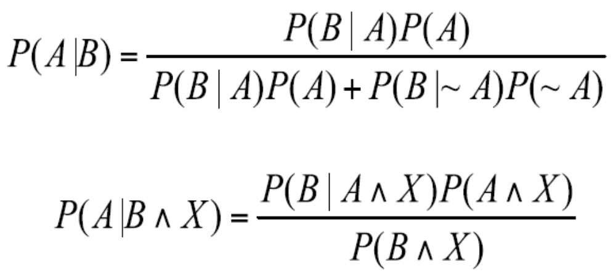
Other Forms of Bayes Rule

Slide 18
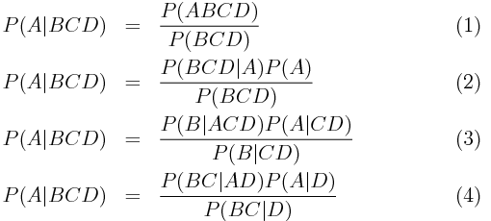
Other Forms of Bayes Rule

Slide 19
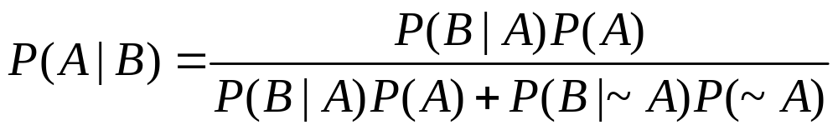
Applying Bayes Rule
A=you have the flu, B=you just coughed
Assume:
P(A)=0.05
P(B|A)=0.80
P(B|~A)=0.2
What is P(flu|cough)=P(A|B)?

Slide 20
What does all this have to do with
function Approximation??
f: X→Y
P(Y|X)

Slide 21
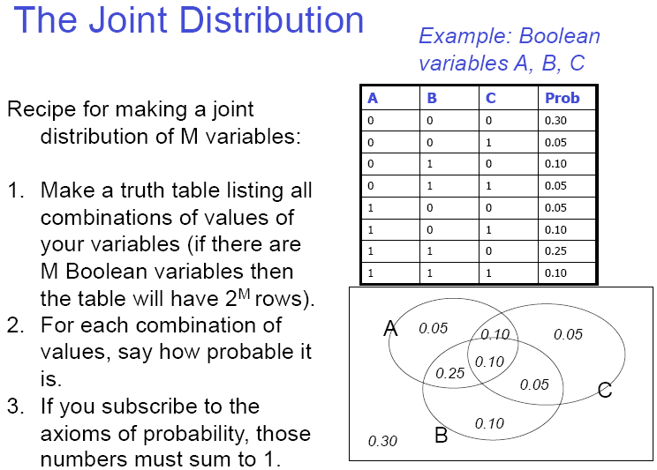
The Joint Distribution

Slide 22
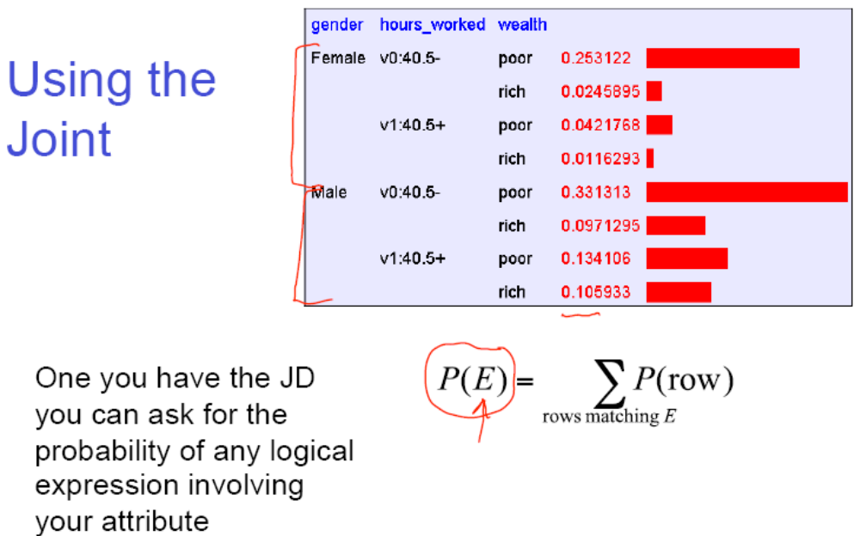
Using the Joint

Slide 23
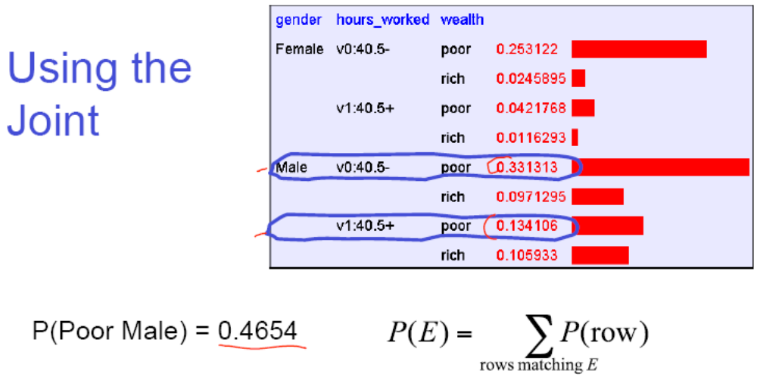

Slide 24
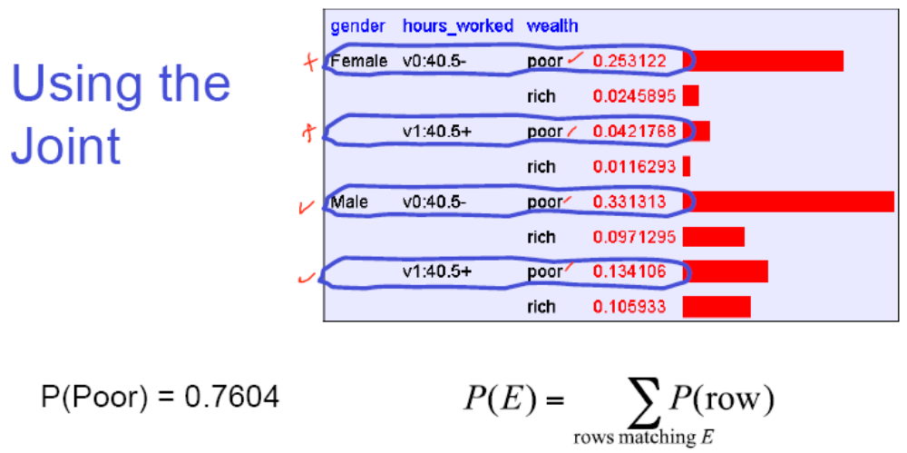

Slide 25
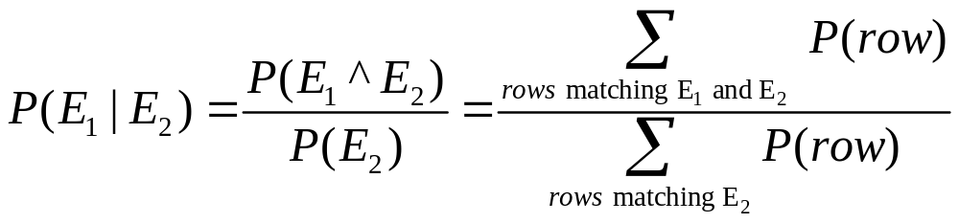
Inference with the Joint
P(Male | Poor)=??

Slide 26
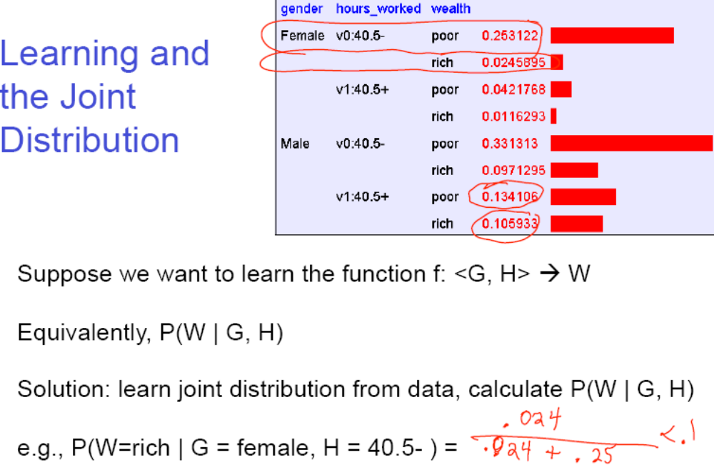

Slide 27
Sounds like the solution to learning
F: X→Y, or P(Y|X).
Are we done?

Slide 28

Your first consulting job
A billionaire asks you a questions:
  He says: I have thumbtack, if I flip it, what’s the probability it will fall with the nail up?
  You say: please flip it a few times:
  You say: The probability is: 0.6!
  He says: Why???

Slide 29
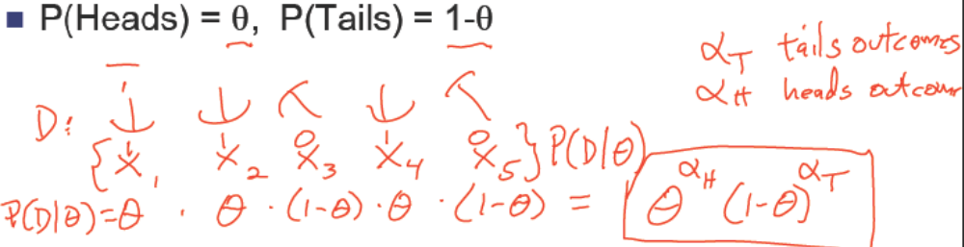

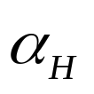

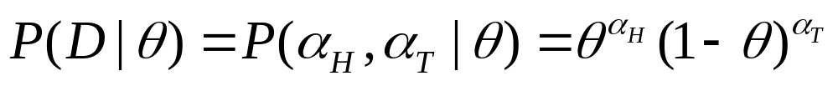
Thumbtack – Binomial Distribution
Flips produce data set D with heads and tails
Flips are independent, identically distributed 1’s and 0’s (Bernoulli)
- and are counts that sum these outcome (Binomial)

Slide 30

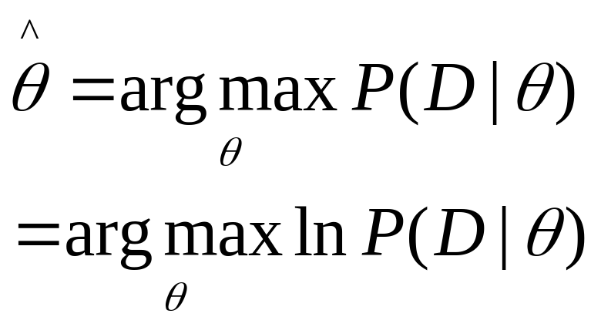
Maximum Likelihood Estimation
Data: Observed set D of Heads and Tails
Hypothesis: Binomial distribution
Learning is an optimization problem
  What is the objective function?
MLE: Choosing that maximizes the probability of observed data:

Slide 31

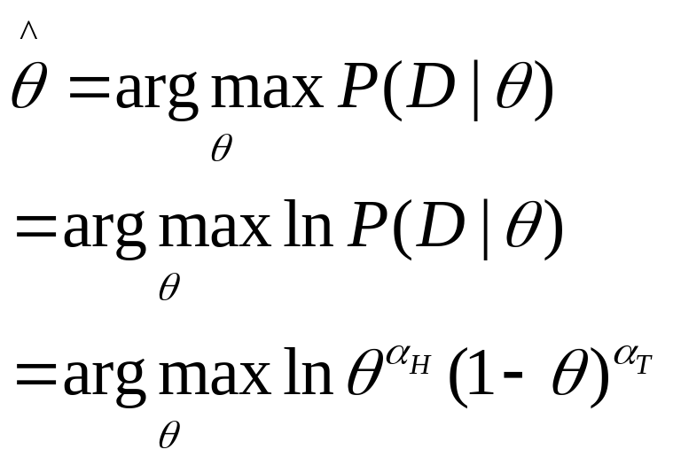
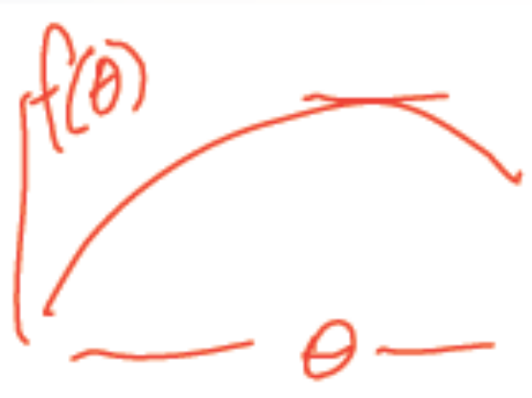
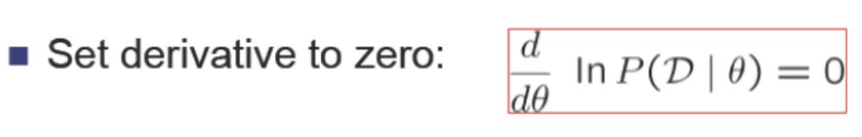
Maximum Likelihood Estimate for

Slide 32
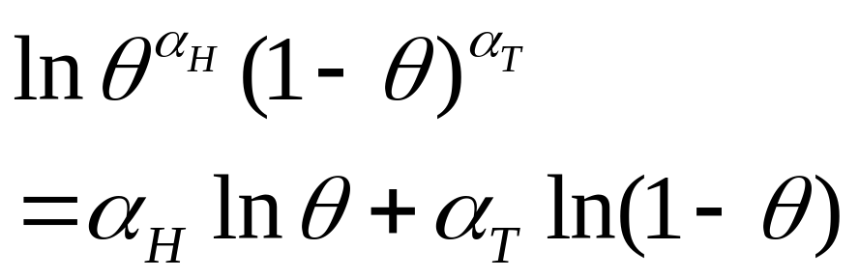
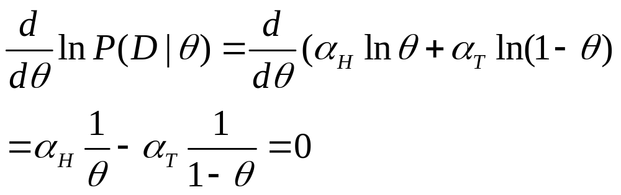
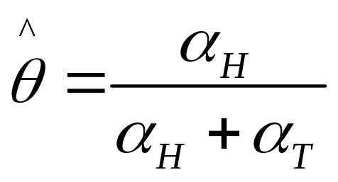

Slide 33
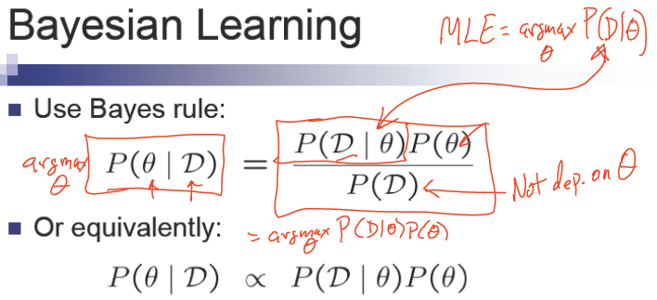
MLE & MAP

Slide 34
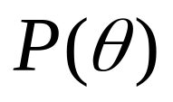
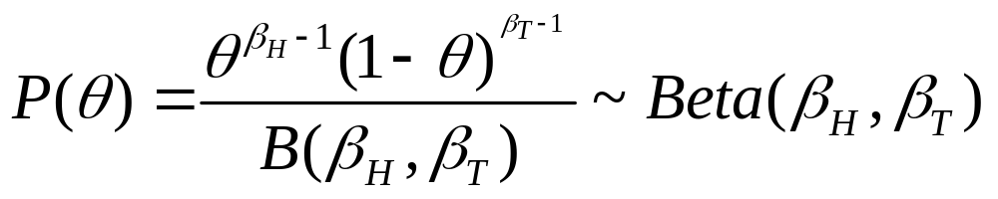
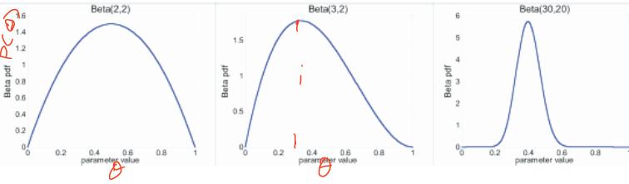
Beta prior distribution –

Slide 35
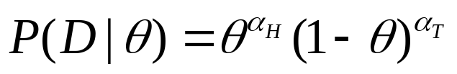
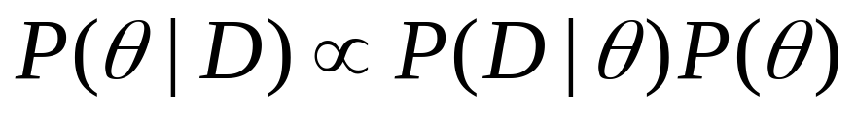
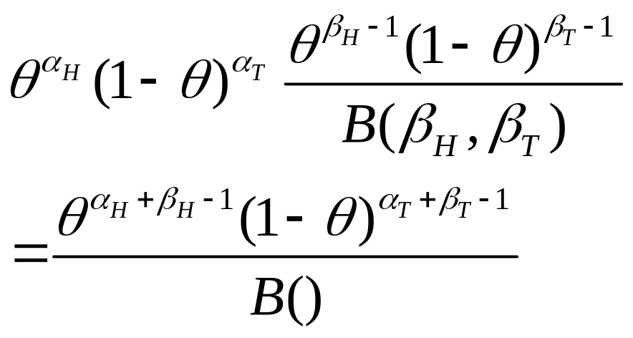
Beta prior distribution –
Likelihood function:
Posterior:

Slide 36
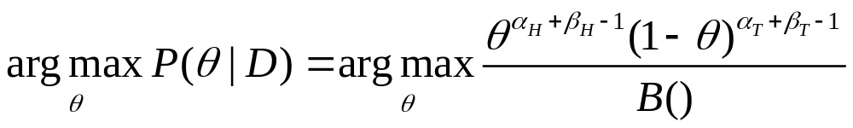
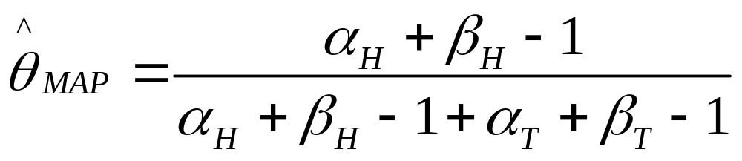
MAP

Slide 37
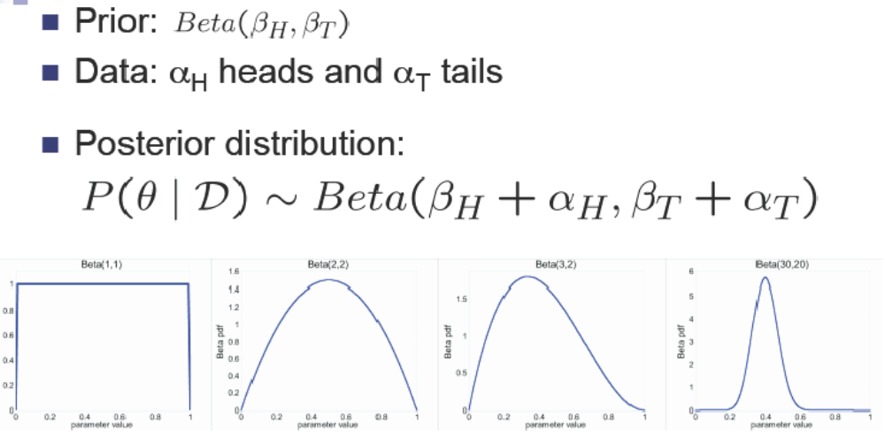
Posterior distribution

Slide 38
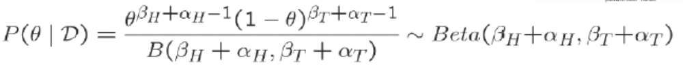
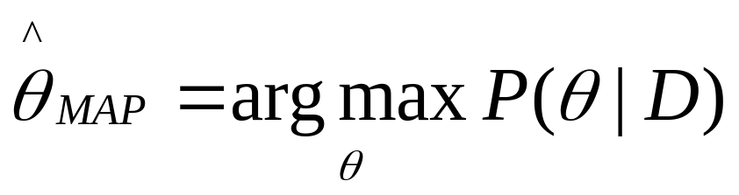

MAP for Beta distribution
MAP: use most likely parameter:
Beta prior equivalent to extra thumbtack flips
As , prior is “forgotten”
But for small sample size, prior is important!!

Slide 39

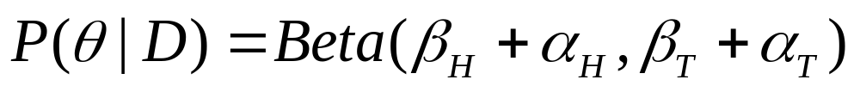
Conjugate priors
Eg.1 Coin flip problem
Likelihood is ~Binomial
If Prior is Beta distribution,
Then posterior is Beta distribution
For Binomial, conjugate prior is Beta distribution.

Slide 40
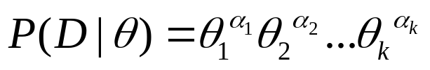
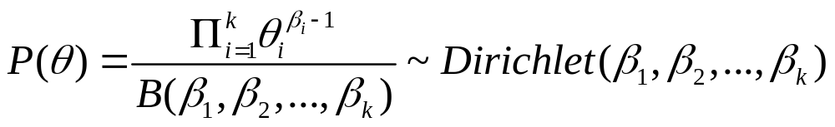
Conjugate priors
Eg.2 Dice roll problem (6 outcomes instead of 2)
Likelihood is ~Multinomial
If Prior is Dirichlet distribution,
Then posterior is Dirichlet distribution
For Multinomial, conjugate prior is Dirichlet distribution.

Slide 41

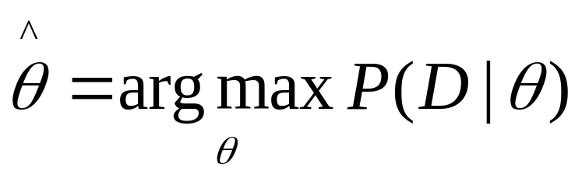
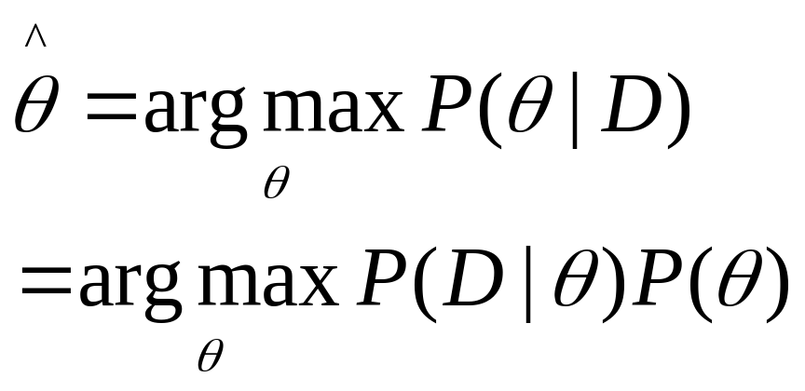
Estimating Parameters
Maximum Likelihood Estimate (MLE): choose that maximizes probability of observed data D
Maximum a Posterior (MAP) : choose that is most probable given prior probability and the data

Slide 42
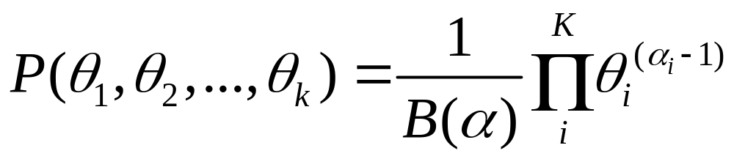
Dirichelet distribution
Number of heads in N flips of a two-sided coin
  Follows a binomial distribution
  Beta is a good prior (conjugate prior for binomial)
What it’s not two-sided, but k-sided?
  Follows a multinomial distribution
  Dirichlet distribution is the conjugate prior

Slide 43
You should know
Probability basics
  Random variables, events, sample space, conditional probs. ..
  Independence of random variables
  Bayes rule
  Joint probability distributions
  Calculating probabilities from the joint distribution
Estimating parameters from data
  Maximum likelihood estimates
  Maximum a posterior estimates
  Distributions-binomial, Beta, Dirichlet, …
  Conjugate priors

Slide 44


Expected values
Given discrete random variable X, the expected value of X, written E[X] is
We also can talk about the expected value of functions of X

Slide 45
Covariance
Given two discrete r.v.’s X and Y, we define the covariance of X and Y as
e.g., X=gender, Y=playsFootball

Slide 46
Summary
Questions?
Thank You!

